Slide 1
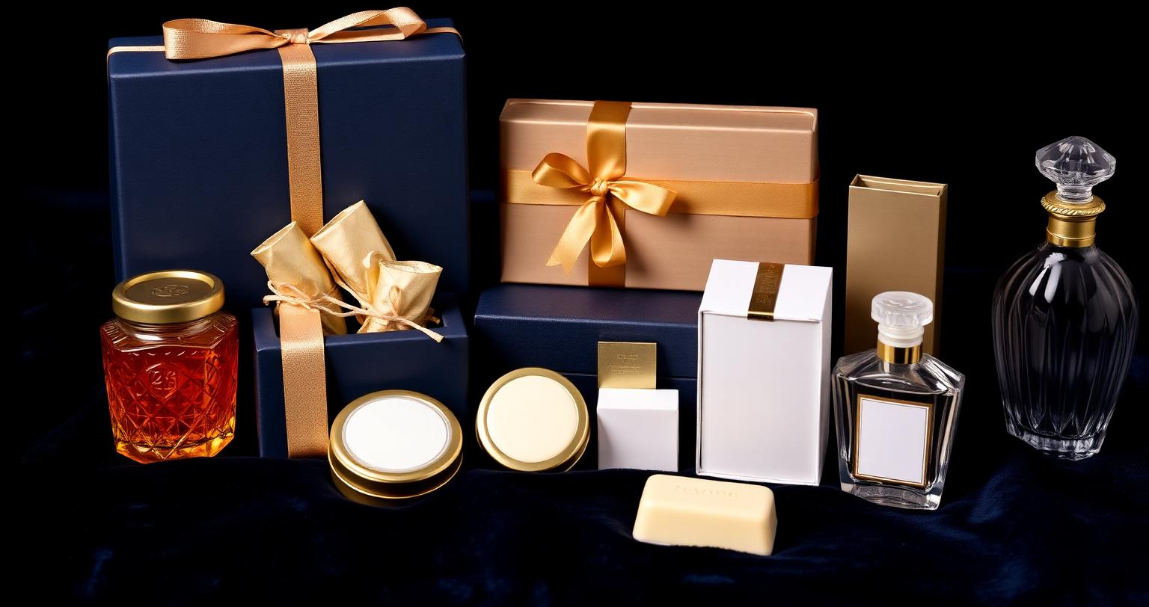
IHS
PREMIUM PRODUCTS & GIFTING
IHS
PREMIUM PRODUCTS
& GIFTING COLLECTION
Curated with Care.
Presented with Elegance.
Remembered with Joy.
IHS TEA
IHS COOKIES
IHS CHOCOLATE
IHS HONEY
LLUMINE PERFUME
LLUMINE HERBAL SOAP
LLUMINE T-SHIRTS
COLLECTION CATALOGUE
IHS · CURATED WITH CARE
01

Slide 2
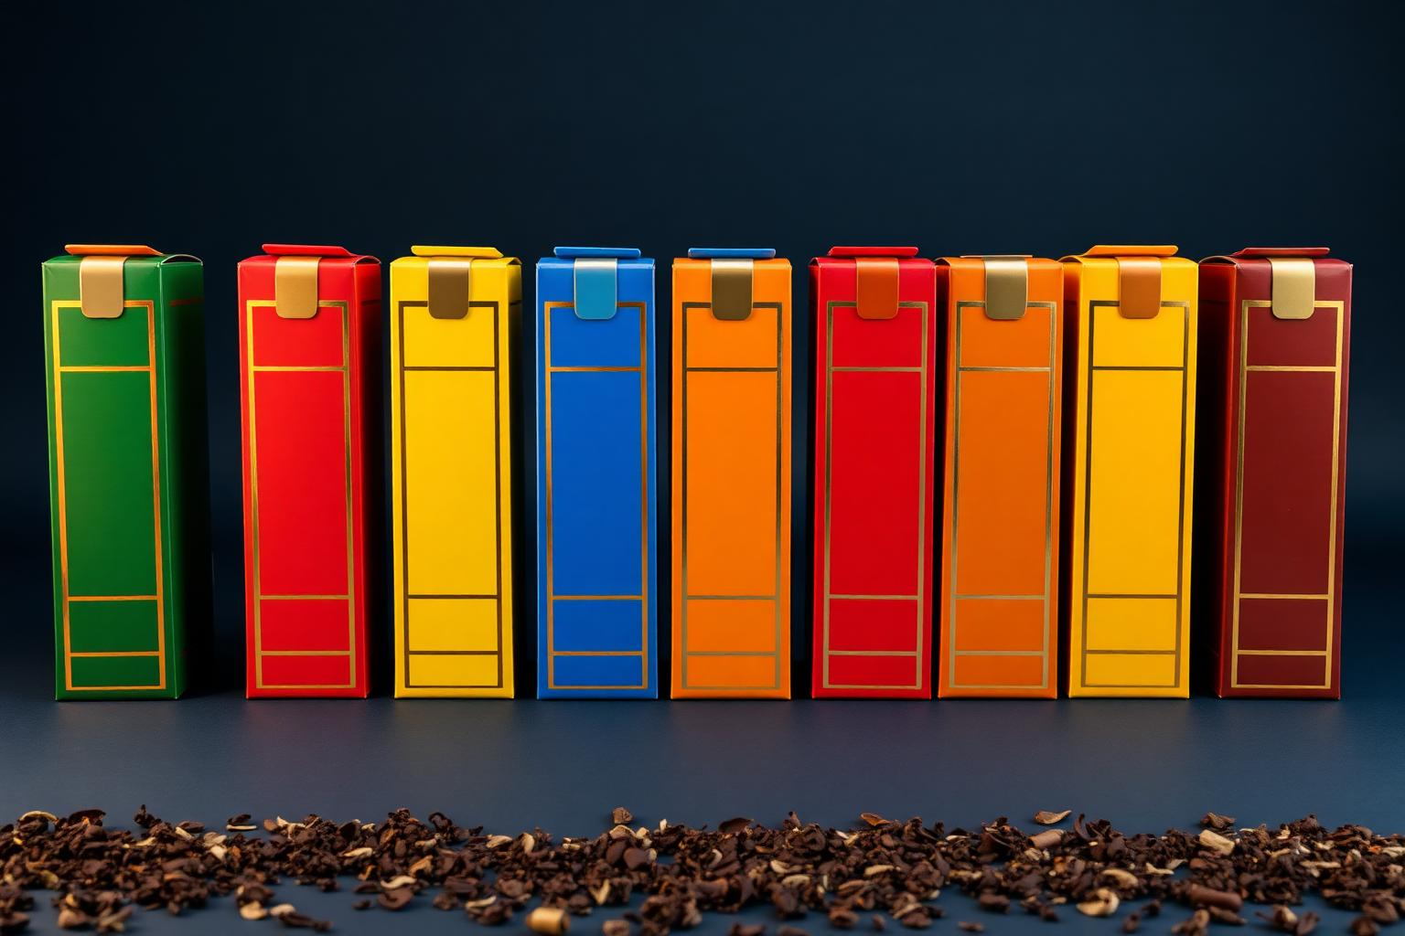
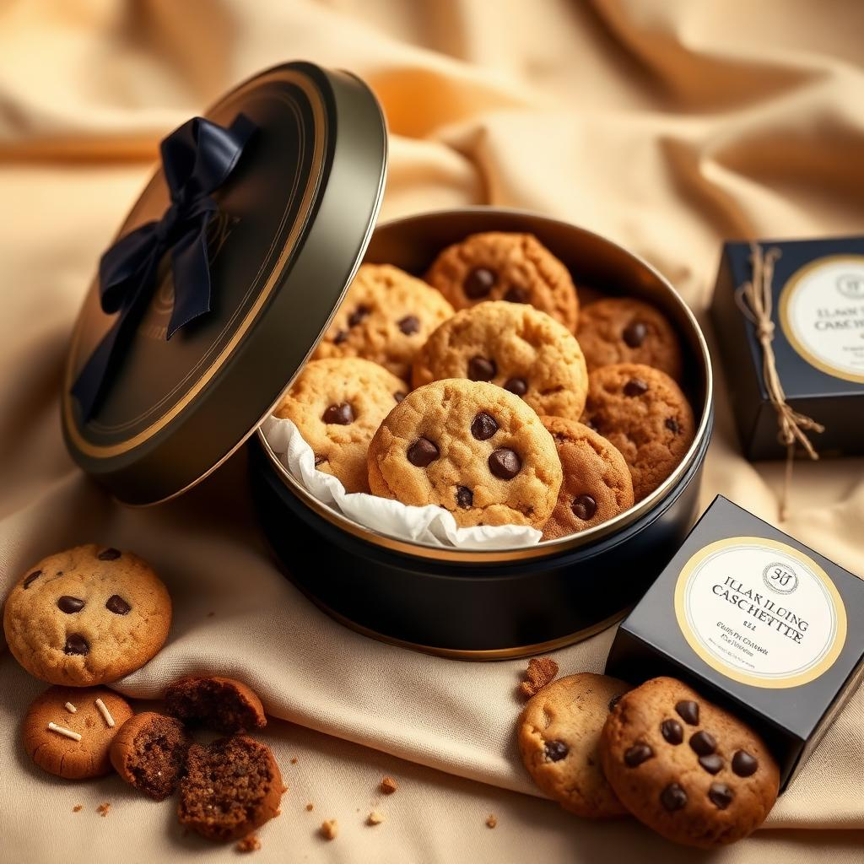
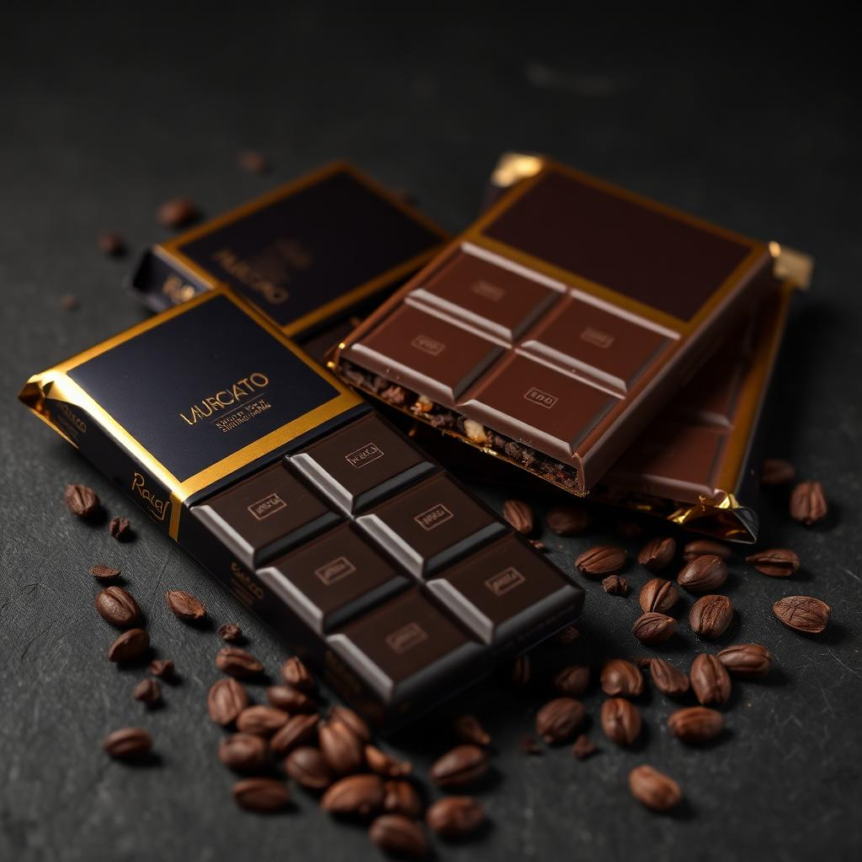
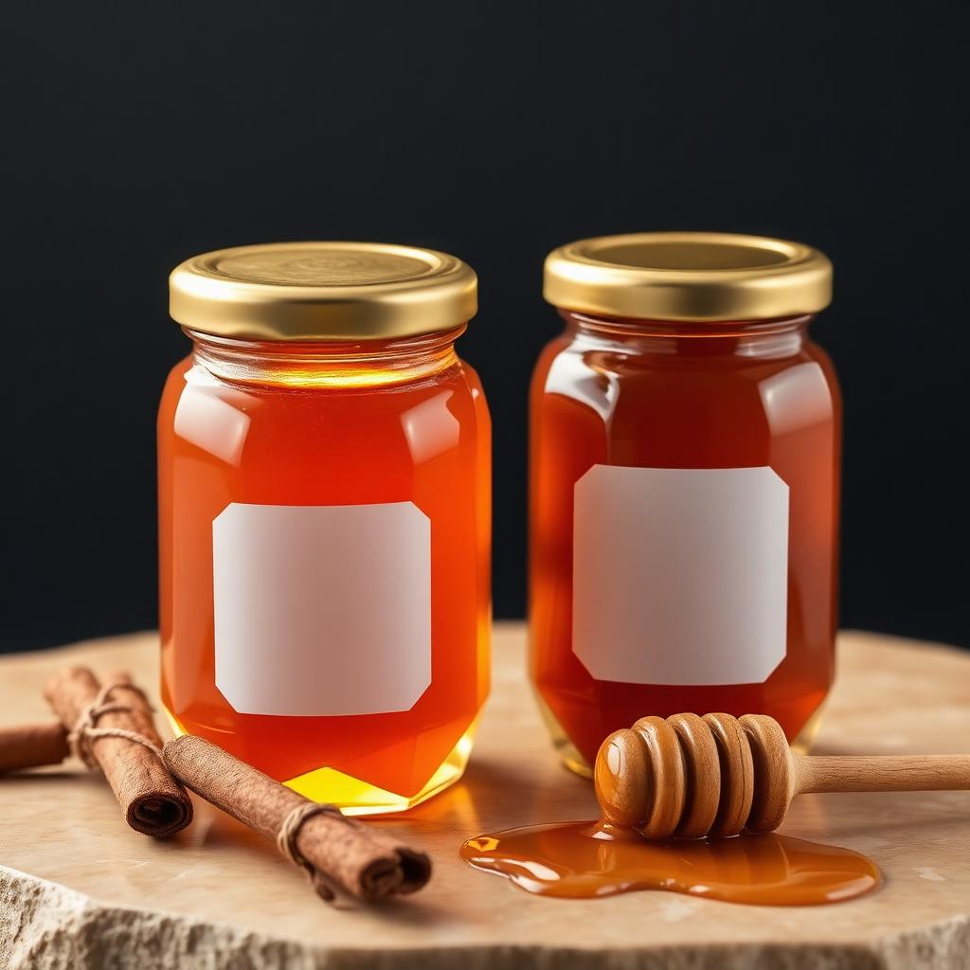
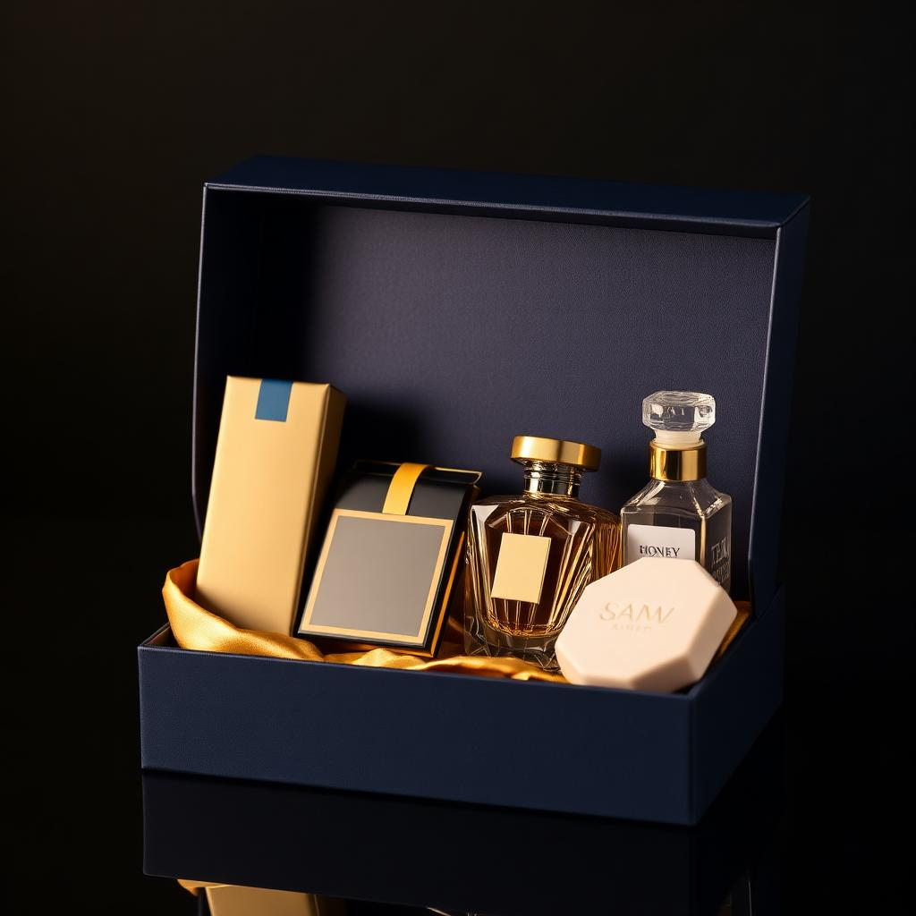
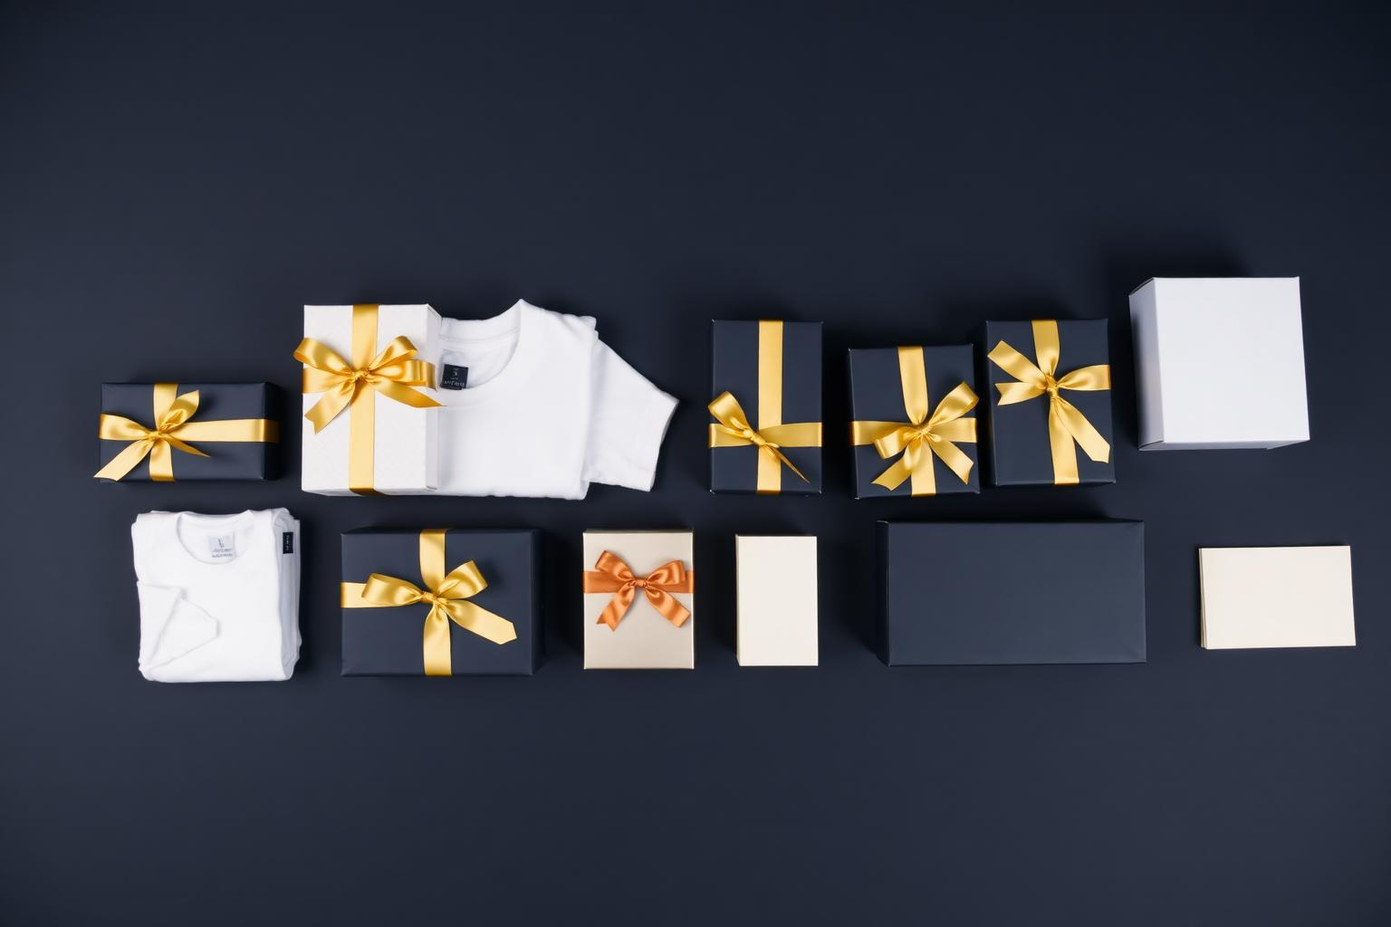

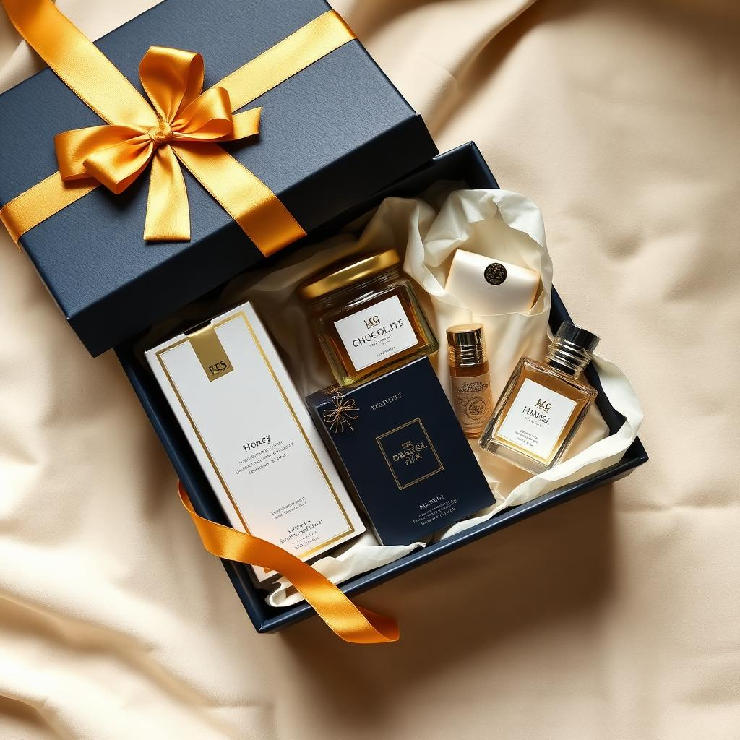
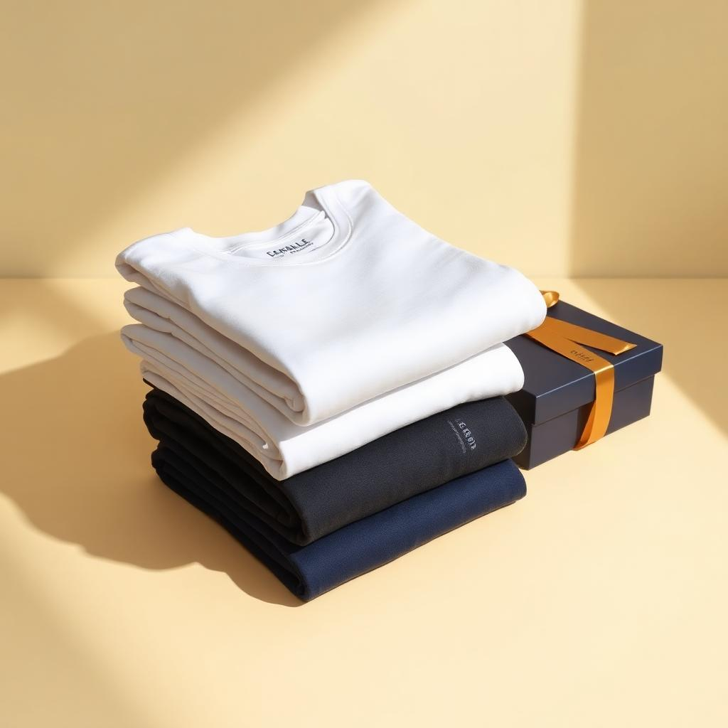
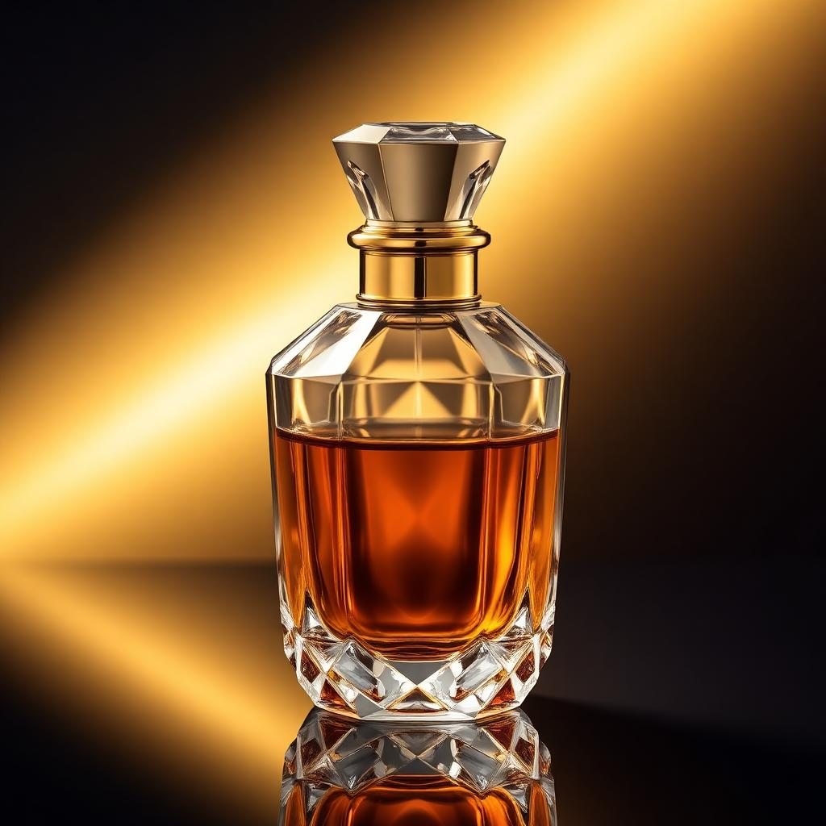
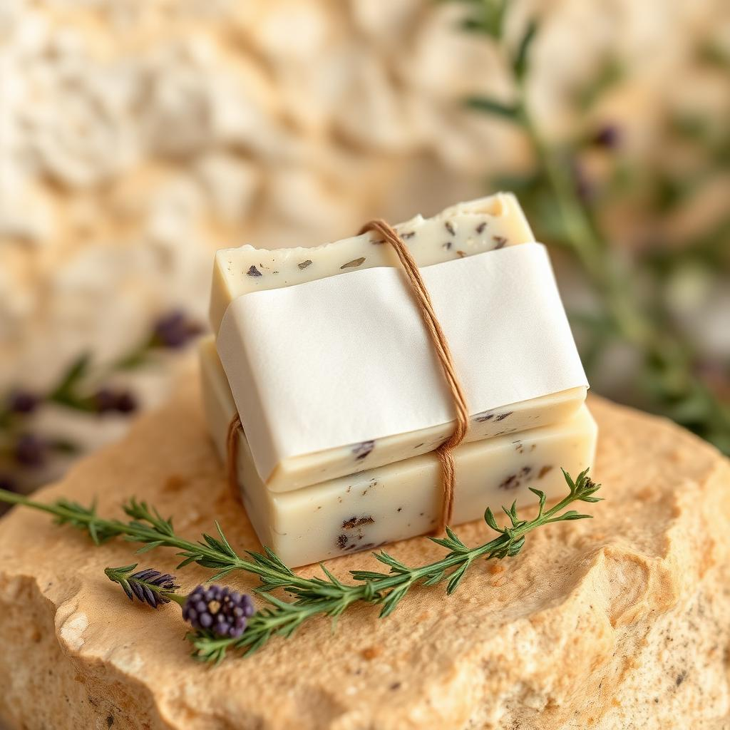
IHS
PREMIUM PRODUCTS & GIFTING COLLECTION
WELCOME
DISCOVER THE
EXPERIENCE
At IHS, thoughtful products and elegant presentation come together to create meaningful gifting experiences. Explore a curated collection of premium tea, gourmet treats, artisan chocolate, honey, hampers, corporate gifting and personalised experiences.
THE IHS COLLECTION
IHS
IHS
IHS
IHS
Premium Tea
Gourmet Cookies
Artisan Chocolate
Premium Honey
IHS
IHS
IHS
IHS
Signature Hampers
Corporate Gifting
Festive Gifting
Bespoke Gifting
FEATURED
Products by
LLUMINE
LLUMINE
LLUMINE
LLUMINE
Customised Printed T-Shirts
Signature Perfumes
Herbal Soaps
DISCOVER THE COLLECTION
IHS · CURATED WITH CARE
02

Slide 3
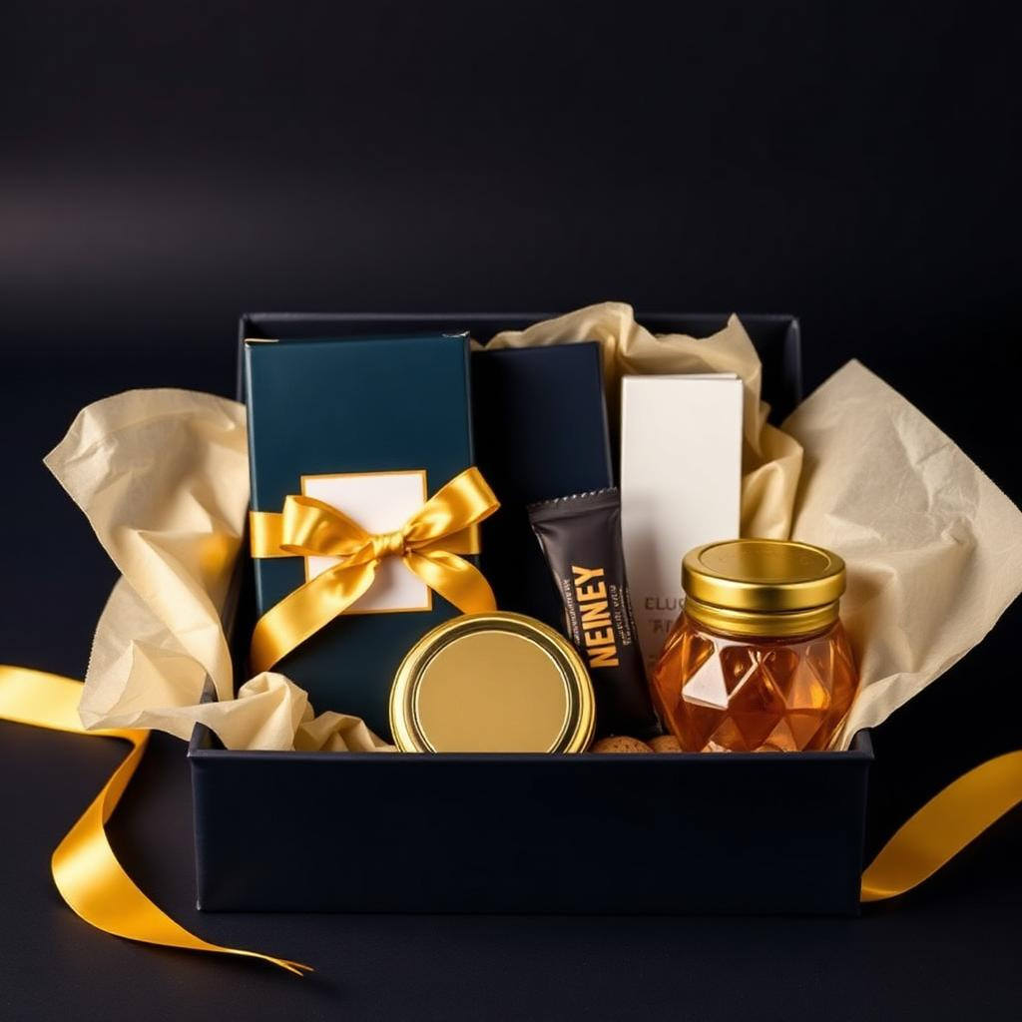
IHS
PREMIUM PRODUCTS & GIFTING COLLECTION
IHS
PREMIUM TEA
COLLECTION
A Flavour for
Every Moment.
NINE SIGNATURE FLAVOURS · EACH CARTON BRANDED IHS
Apple
Blood Orange
Chamomile
Crisp orchard sweetness, gently spiced.
Bright citrus with a deep ruby finish.
Soft floral calm for quiet evenings.
Blueberry
Lemon
Honey Lemon
Ripe berry depth, smooth and rounded.
Clean, zesty lift from the first sip.
Golden warmth balanced with citrus.
Mango
Strawberry
Cinnamon
Sun-ripened tropical fullness.
Delicate summer fruit, lightly sweet.
Warm spice with a lingering finish.
HERO PRESENTATION
IHS TEA DISCOVERY
COLLECTION
Explore. Taste. Discover.
IHS PREMIUM TEA COLLECTION
IHS · CURATED WITH CARE
03

Slide 4
IHS
PREMIUM PRODUCTS & GIFTING COLLECTION
IHS
GOURMET COLLECTION
A Little Indulgence.
Beautifully Presented.
IHS
IHS Gourmet Cookies
Chocolate Chip
Butter Cookies
Fruit Cookies
Herbal Cookies
Festive Cookies
Slow-baked in small batches, presented in navy and gold keepsake tins.
IHS
IHS Artisan Chocolate
Dark Chocolate
Milk Chocolate
Fruit & Nut Chocolate
Premium Gift Chocolate
Farm-to-bar cocoa, foil-wrapped and boxed for gifting.
IHS
IHS Premium Honey
Pure Honey
Cinnamon Honey
Honey Gift Collection
Raw, unblended honey in faceted glass with gold closures.
IHS GOURMET COLLECTION
IHS · CURATED WITH CARE
04

Slide 5
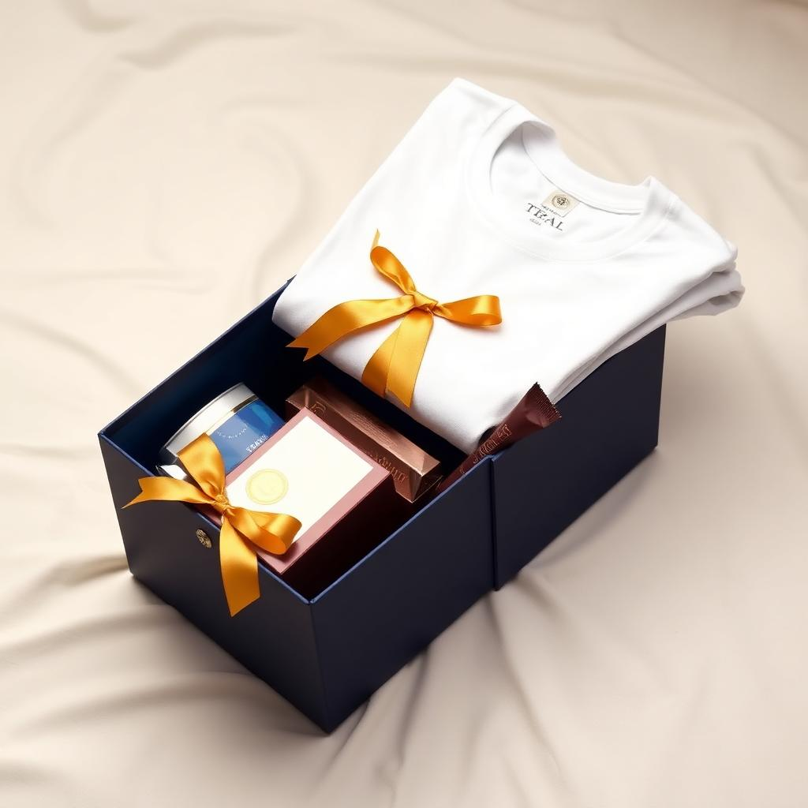
IHS
PREMIUM PRODUCTS & GIFTING COLLECTION
IHS HAMPER COLLECTION
THE COMPLETE
HAMPER COLLECTION
Hampers 01 – 03
01
IHS Wellness Box
INCLUDES
IHS Premium Herbal Tea
IHS Premium Honey
IHS Artisan Chocolate
LLUMINE Herbal Soap
LLUMINE Signature Perfume
PERFECT FOR
Wellness | Appreciation | Personal Gifting
02
IHS Gourmet Delight Box
INCLUDES
IHS Premium Tea
IHS Gourmet Cookies
IHS Artisan Chocolate
IHS Premium Honey
PERFECT FOR
Clients | Families | Festive Gifting
03
IHS Corporate Appreciation Box
INCLUDES
IHS Premium Tea
IHS Gourmet Cookies
IHS Artisan Chocolate
LLUMINE Customised Printed T-Shirt
PERFECT FOR
Employees | Teams | Events | Institutions
IHS SIGNATURE HAMPERS
IHS · CURATED WITH CARE
05

Slide 6
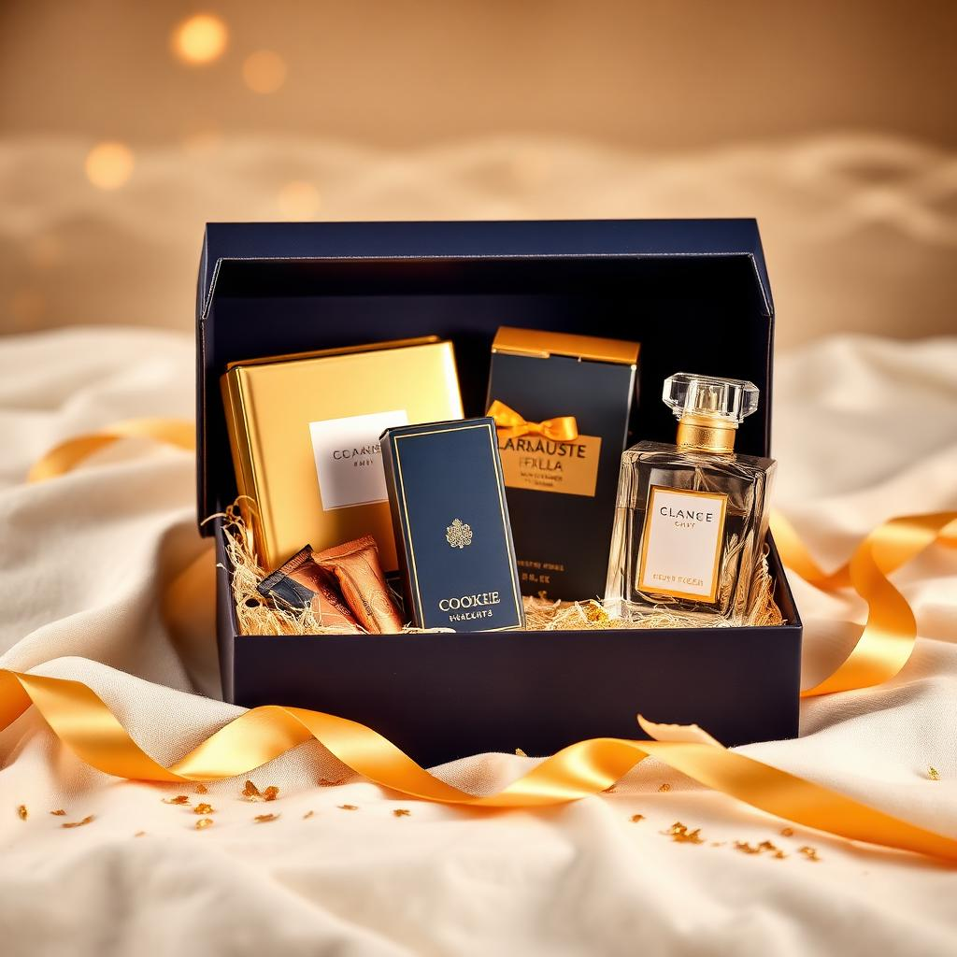
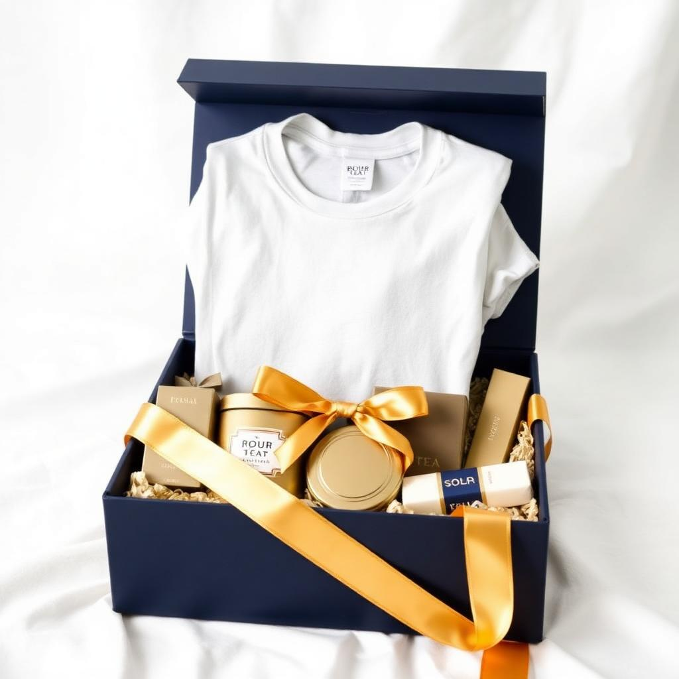
IHS
PREMIUM PRODUCTS & GIFTING COLLECTION
IHS HAMPER COLLECTION
HAMPERS FOR
EVERY OCCASION
Hampers 04 – 06
04
IHS Signature Luxury Box
INCLUDES
IHS Premium Tea
IHS Artisan Chocolate
IHS Premium Honey
LLUMINE Signature Perfume
LLUMINE Herbal Soap
PERFECT FOR
VIP Gifting | Leadership | Premium Occasions
05
IHS Celebration Box
INCLUDES
IHS Gourmet Cookies
IHS Artisan Chocolate
IHS Premium Tea
LLUMINE Signature Perfume
PERFECT FOR
Birthdays | Anniversaries | Celebrations
06
IHS Team Experience Box
INCLUDES
LLUMINE Customised Printed T-Shirt
IHS Premium Tea
IHS Gourmet Cookies
IHS Artisan Chocolate
LLUMINE Herbal Soap
PERFECT FOR
Teams | Conferences | Brand Events
IHS SIGNATURE HAMPERS
IHS · CURATED WITH CARE
06

Slide 7
LLUMINE
FEATURED PRODUCTS BY LLUMINE
LLUMINE
FEATURED PRODUCTS
BY LLUMINE
Personalised.
Refined. Memorable.
Three LLUMINE product families complete the gifting experience. Tea, cookies, chocolate, honey and hampers remain curated and branded by IHS.
LLUMINE
LLUMINE Customised Printed T-Shirts
Corporate T-Shirts
Event T-Shirts
Employee T-Shirts
Institution T-Shirts
Personalised T-Shirts
Combed premium cotton, custom print placement, folded into navy presentation boxes.
LLUMINE
LLUMINE Signature Perfumes
Luxury Perfume Bottles
Premium Faceted Glass
Elegant Gold-Framed Labels
Gift-Ready Packaging
Signature blends presented in gold-collared crystal with silk-lined cases.
LLUMINE
LLUMINE Herbal Soaps
Herbal Soap Bars
Premium Wrapped Packaging
Botanical Ingredients
Natural Lifestyle Presentation
Cold-processed bars with botanical inclusions, wrapped in ivory paper and gold banding.
FEATURED PRODUCTS BY LLUMINE
IHS · CURATED WITH CARE
07

Slide 8
IHS
PREMIUM PRODUCTS & GIFTING COLLECTION
IHS CORPORATE & PERSONALISED GIFTING
YOUR BRAND.
BEAUTIFULLY PRESENTED.
IHS creates premium gifting experiences for organisations, teams, events and special occasions through carefully selected products, personalisation and elegant presentation.
PROGRAMMES
01
02
03
04
05
Employee Appreciation
Client Gifting
Conference & Event Gifts
Welcome Kits
Personalised Celebration Gifts
CUSTOMISATION OPTIONS
OPTIONAL LLUMINE ADDITIONS
Product Selection
Event Identity
Customised Printed T-Shirts
Personalised Names
Custom Gift Cards
Signature Perfumes
Messages
Premium Packaging
Herbal Soaps
Corporate Branding
CORPORATE & PERSONALISED GIFTING
IHS · CURATED WITH CARE
08

Slide 9
IHS
PREMIUM PRODUCTS & GIFTING COLLECTION
IHS FESTIVE GIFTING
GIFT THE MOMENT
Christmas | Diwali | New Year
IHS
Christmas Collection
Premium Tea · Gourmet Cookies
Artisan Chocolate · Cinnamon Honey
Optional LLUMINE Perfume & Herbal Soap
IHS
Diwali Collection
Festive tea, cookies and chocolate in gold-lined boxes
Cinnamon honey with brass-toned festive detailing
IHS
New Year Collection
Celebration hampers with signature tea and chocolate
Personalised cards and premium gold packaging
BESPOKE BY IHS
YOUR OCCASION. YOUR CHOICE.
YOUR EXPERIENCE.
Six Simple Steps
01
Choose Your Occasion
02
Select Your IHS Products
Corporate, festive, personal or institutional.
Tea | Cookies | Chocolate | Honey
03
Add LLUMINE Products
04
Personalise Your Gift
Printed T-Shirts, Perfumes, Herbal Soaps.
Names | Messages | Branding
05
Choose Your Packaging
06
Create Something Memorable
Essential | Signature | Luxury
IHS curates the complete experience.
IHS FESTIVE & BESPOKE GIFTING
IHS · CURATED WITH CARE
09

Slide 10
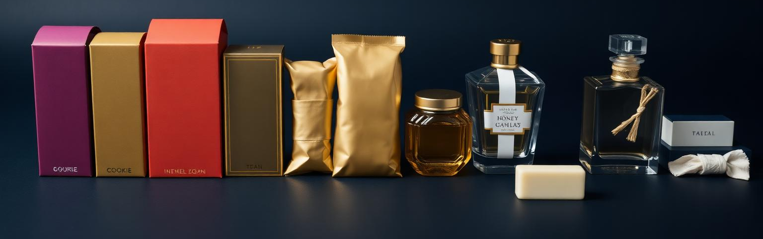
IHS
LET’S CREATE
SOMETHING MEMORABLE.
Premium Products. Thoughtful Gifting.
Beautiful Presentation.
Whether you are celebrating a special occasion, appreciating your team, thanking a valued client or creating a meaningful brand experience, IHS is ready to help you create a gift worth remembering.
WEBSITE
EMAIL
[ WEBSITE ]
[ EMAIL ]
PHONE
WHATSAPP
[ PHONE ]
[ WHATSAPP ]
SOCIAL MEDIA
ENQUIRIES
[ SOCIAL MEDIA ]
[ CONTACT PERSON ]
Curated with Care. Presented with Elegance. Remembered with Joy.
CONTACT IHS
IHS · CURATED WITH CARE
10

